Slide 1
Llama Deception VR
By Will Hobbs

Slide 2
Intro
“Llama Deception VR” is a VR platformer game. The aim is to reach the summit of the underground Incan vault whilst avoiding falling into the pit of despair. You will be accompanied by a cute llama that you found down in the depths of the vault who’s attitude may not be what it first seems.
Why VR?
Get up close to Inca art
Can see the challenge presented above you
More frustrating for those afraid of heights

Slide 3
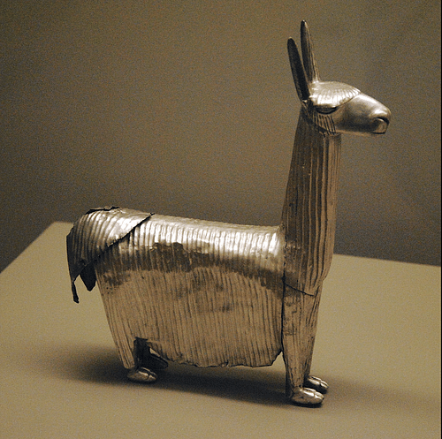
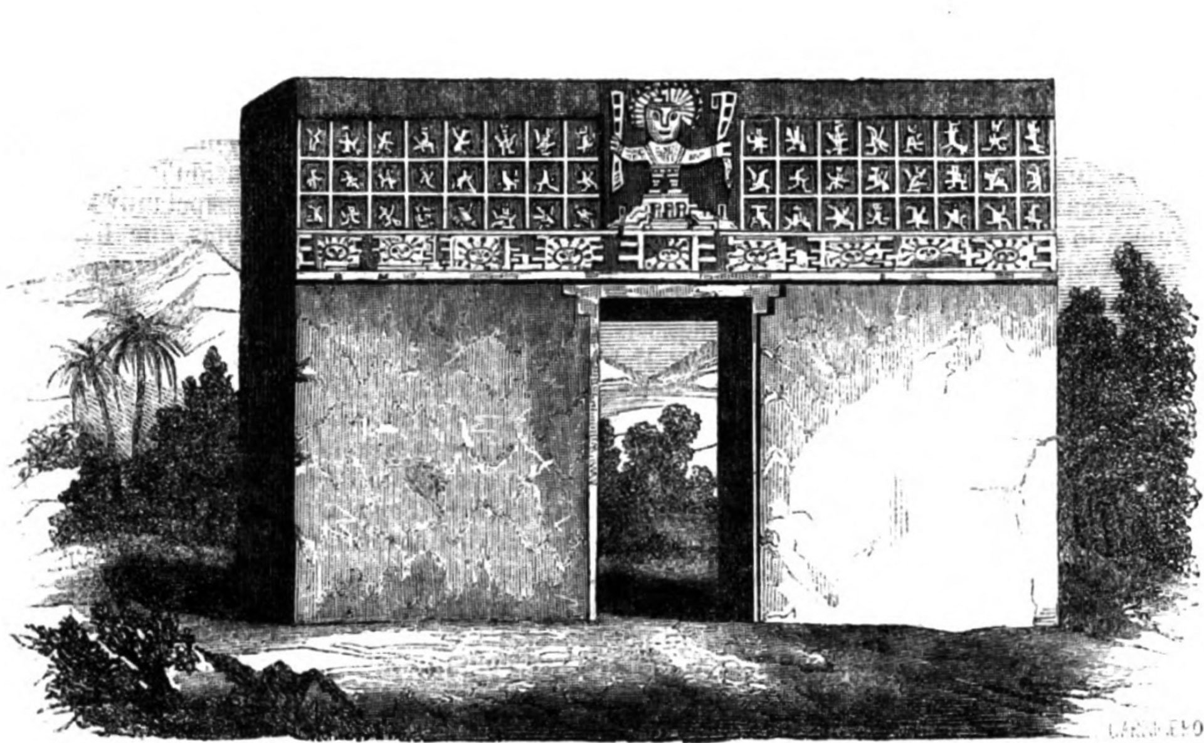
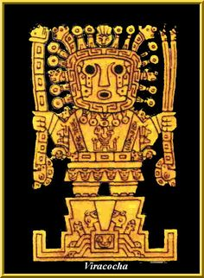
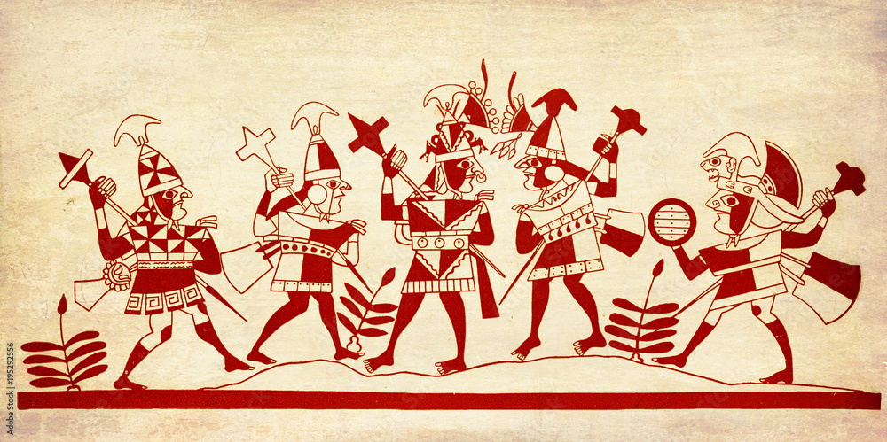
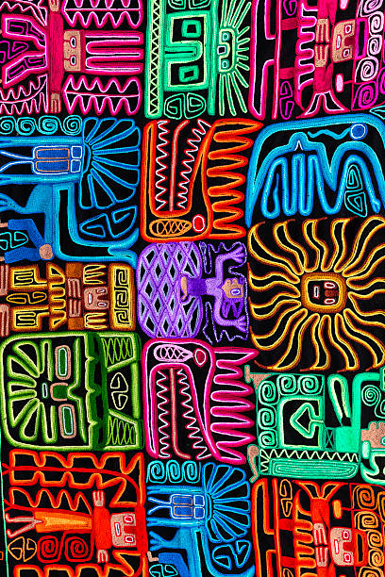
Inca Theme
https://artslondon.padlet.org/whobbs0120191/fmp_inca_empire

Slide 4
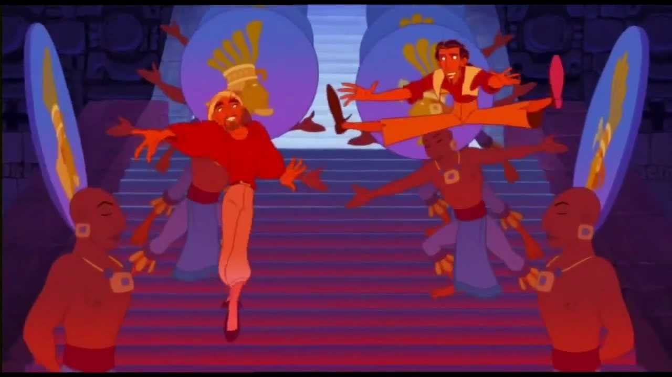
Theme Inspiration
The Emperor’s New Groove (2000) – Disney
The Road to El Dorado - Dreamworks

Slide 5
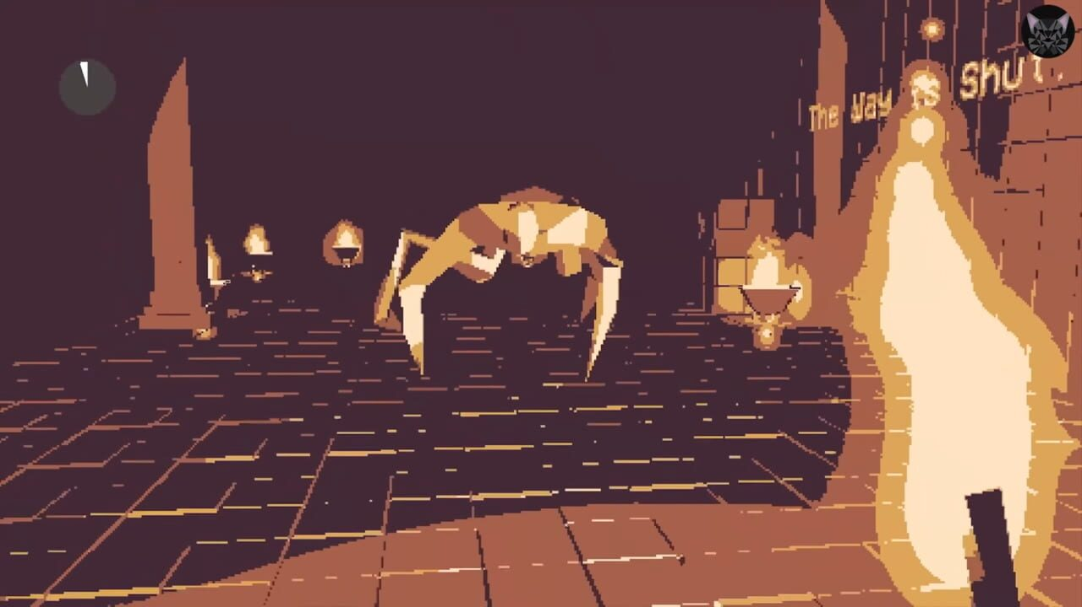
Crypt - Valefisk
First inspiration for frustration game
Sadistic
Torture
Unbeatable
Puzzles with random answers; no relation to puzzle clues/patterns
Looping maze with long corridors leading to dead ends
Rooms hidden using viewing angles
Monster beelines to you faster than you can sprint upon collecting all the keys
Even if you make it to the exit with the keys, it doesn’t unlock
https://www.youtube.com/watch?v=KD03ljcM434
https://artslondon.padlet.org/whobbs0120191/fmp_inspiration

Slide 6
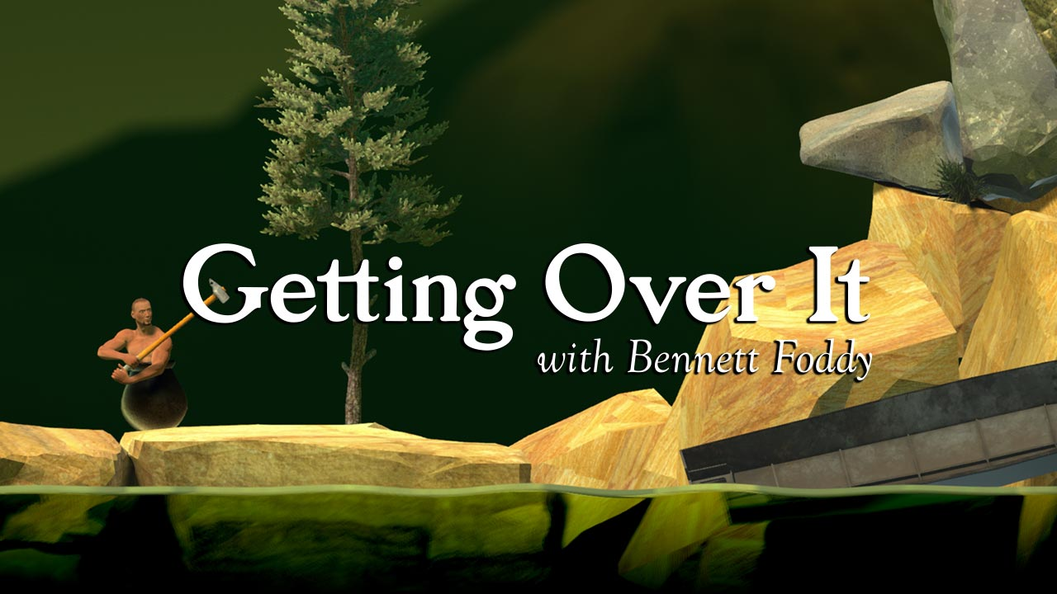
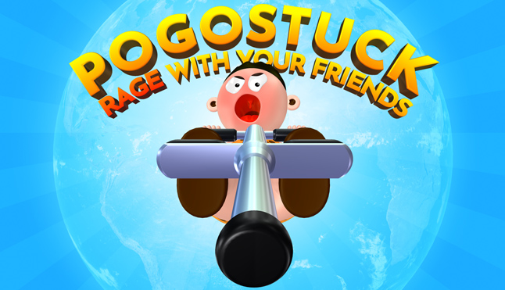
Frustrating Platformers
Getting Over It With Bennett Foddy – Bennett Foddy
Pogostuck: Rage With Your Friends – Hendrix Felix Pohl
Jump King - Nexile

Slide 7
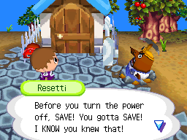
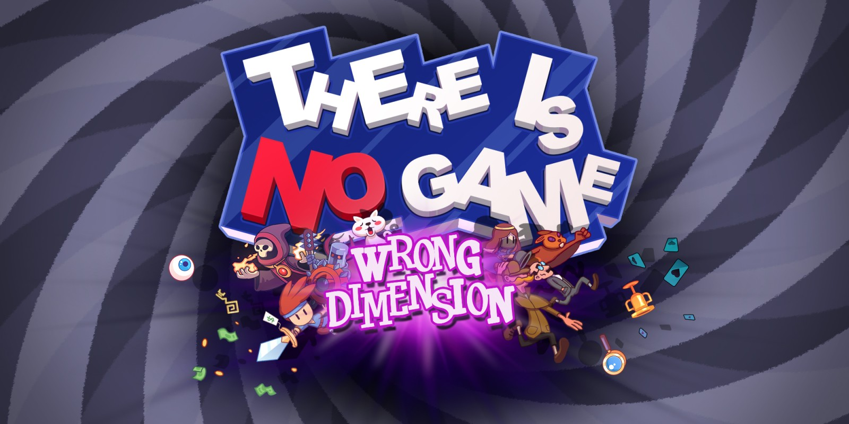
Frustrating Characters
Mr. Resetti – Animal Crossing – Nintendo
Narrator – Getting Over It With Bennett Foddy – Bennett Foddy
The Player – The Stanley Parable – Galactic Café
The Player – There Is No Game: Wrong Dimension – Draw Me A Pixel

Slide 8
Gameplay
Platformer
Falling off a platform results in simple but repetitive frustrating gameplay
Llama companion giving hints
Llama’s personality is terrible – makes snide/passive aggressive remarks, wrong hints, etc.
Moving platforms
Dead ends resulting in backtracking
Most platforms won’t be directly above another platform resulting in long distance falls
https://artslondon.padlet.org/whobbs0120191/fmp_little_companion_buddy
https://artslondon.padlet.org/whobbs0120191/fmp_puzzle_games

Slide 9
Mechanics
Simple controls – walk, sprint, jump, grab
Falling off the edge of a platform results in instant teleportation to the “platform” directly below the player – reduces motion sickness
Sprinting allows for further jumps than walking
Moving platforms
Procedural animation for llama companion’s movements following the player
https://artslondon.padlet.org/whobbs0120191/fmp_animations

